Slide 1

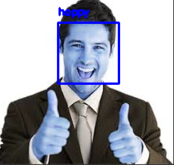
Emotion Recognition
Roll No. = 17MF10003
Name = Akshat Suwalka

Slide 2
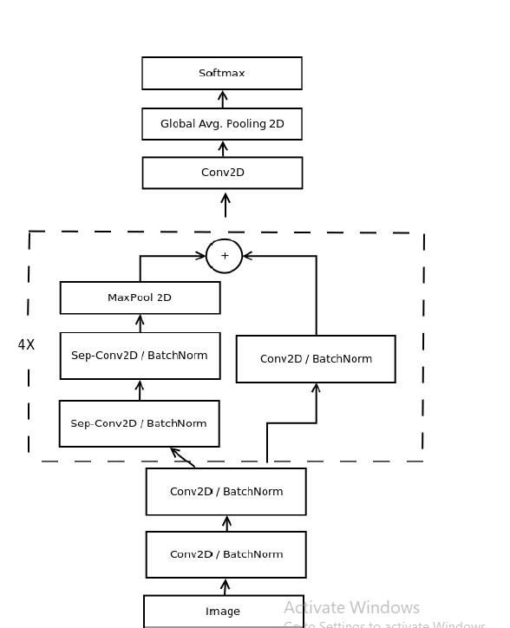
Real-time Convolutional Neural Networks for
Emotion and Gender Classification
Octavio Arriaga , Paul G. Pl¨oger, Matias Valdenegro

Slide 3
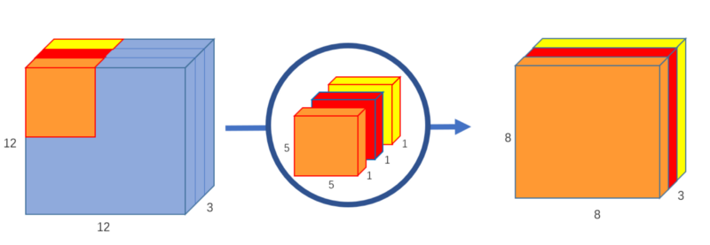
Following the previous architecture schemas, our initial architecture used Global Average Pooling to completely remove any fully connected layers. This was achieved by having in the last convolutional layer the same number of feature maps as number of classes, and applying a SoftMax activation function to each reduced feature map.
Our final architecture is a fully-convolutional neural network that contains 4 residual depth-wise separable convolutions where each convolution is followed by a batch normalization operation and a ReLU activation function. The last layer applies a global average pooling and a soft-max activation function to produce a prediction.
Depth wise separable
convolution

Slide 4
All sub-figures contain the same images in the same order. Every row starting from the top corresponds respectively to the emotions: angry, happy, sad and surprise.
1st photo is Samples from the FER-2013 dataset(From Kaggle).
2nd is the Guided visualization of model form by the CNN network
3rd is further visualization of how model transforming data
Real-time Convolutional Neural Networks for
Emotion and Gender Classification

Slide 5
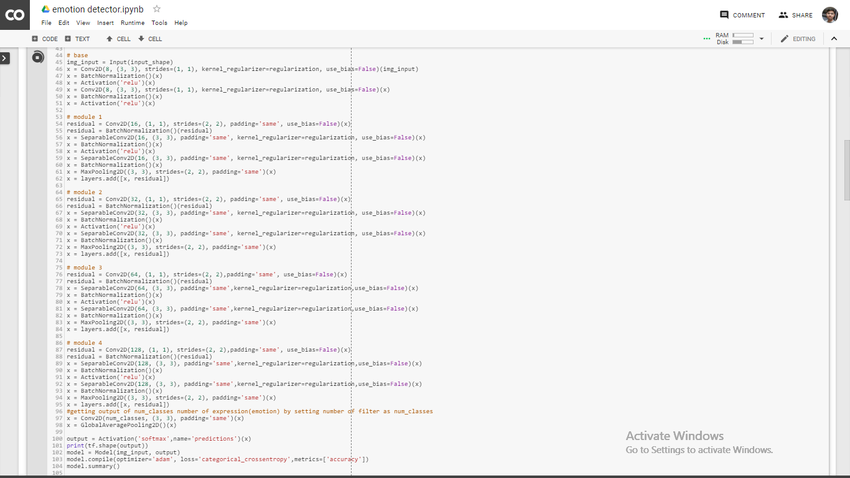
Main Code :-

Slide 6

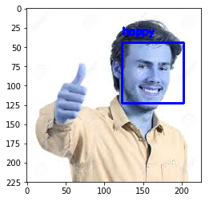
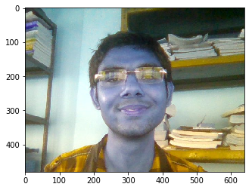
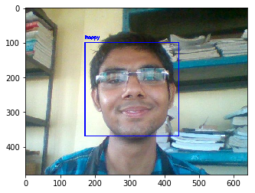
Happy

Slide 7
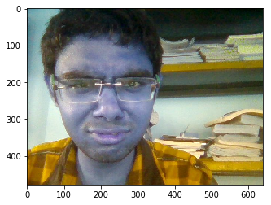
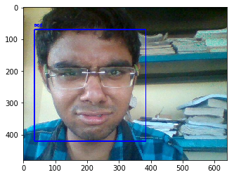

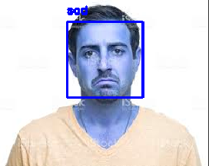
Sad

Slide 8

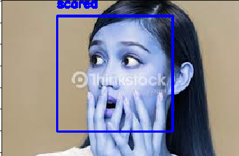

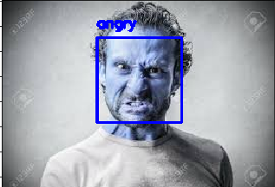
Scared
Angry

